Slide 1


Used Bike Sales Analysis
Exploring factors influencing used bike prices. Presented by your analyst, date: today.
by Chanchal Narang

Slide 2

Understanding the Used Bike Market
Market Importance
Price Factors
Significant segment of automotive industry
Crucial for buyers, sellers, and businesses
Analysis Aim
Dataset
Explore factors and market dynamics
Used bike sales data from online listings

Slide 3

Project Goals
Key Features
Price Distribution
Target feature is Price
Explore bike prices
Influencing attributes:
and attributes
Power
kms_driven
Mileage
Model_year
Market Trends
location-based pricing
Year-Based pricing

Slide 4
Data Overview
Dataset Details
Data Preparation
Thousands of listings
Cleaned missing values
Model, year, mileage, owner, location, price
Typed conversions
Feature extraction from model names
Unique Categories
Key properties like Granularity, scope, temporality, faithfulness of Data kept in mind

Slide 5
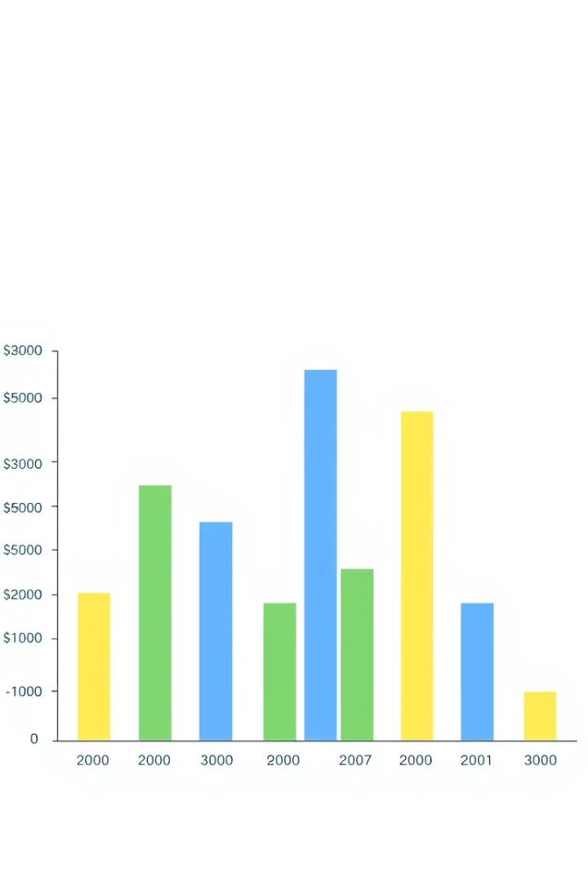


Price Distribution
Observations
Most bikes priced low with a long high-price tail
Market Insight
Wide product range, mostly affordable models

Slide 6



Price vs. Model Year
Variability
Depreciation not sole factor
Newer Models
Business Relevance
Generally higher prices
Model year affects pricing decisions
2
1
3

Slide 7
Kms Driven vs. Owner
Observation
First owners tend to have fewer kms driven
Impact
Lower mileage can increase bike price
Market Insight
Owner history critical for valuation

